Slide 1


Webpage Revision Guideline

Slide 2
FAQ
TOOLS WEBPAGE REVISION GUIDELINE
Web Flow: The user journey should be Login Page → Welcome Page after a successful login.
Revision Scope: Please focus the revisions on the areas highlighted with numbered boxes. The numbers serve as references for the corresponding notes and explanations.

Slide 3
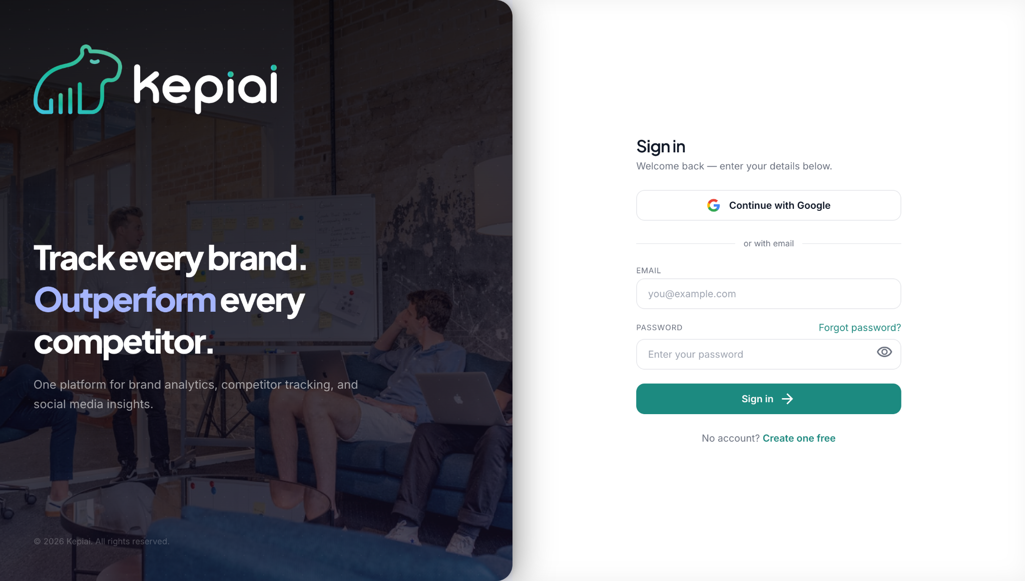
LOGIN PAGE: REVISION BRIEF
TOOLS WEBPAGE REVISION GUIDELINE
1
Please update the background design for this section using the color gradient from the following slide.
1
HEADLINE
2
Please update the copy from the blue box below using the provided material, and apply a color combination that aligns with KepiAi's brand guidelines.
2
SUPPORTING PARAGRAPH
Headline:
Chill.
We've Got The Metrics.
Supporting Paragraph:
Every platform gives you metrics, while KepiAi gives you clarity. We bring your performance, content, audience, and campaigns into one intelligent workspace, reveal what actually drives results, and turn days of reporting into minutes, so you can spend less time explaining the numbers and more time acting on them.

Slide 4
LOGIN PAGE: COLOR GRADIENT REVISION BRIEF
TOOLS WEBPAGE REVISION GUIDELINE

Slide 5
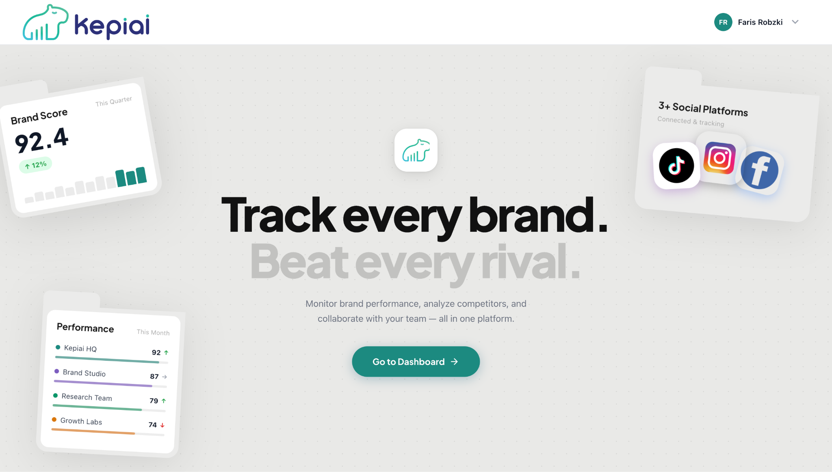
WELCOME PAGE: REVISION BRIEF
TOOLS WEBPAGE REVISION GUIDELINE
Please update the design of the visual elements in this section according to the detailed brief provided on the following slide.
1
1
HEADLINE
2
SUPPORTING PARAGRAPH
CTA
Please update the copy from the blue box below using the provided material, and apply a color combination that aligns with KepiAi's brand guidelines.
2
Headline:
The data is in.
The next move is yours.
Supporting Paragraph:
We've organized your metrics, surfaced the insights, and prepared the reports.
Now it's time to decide with confidence.
CTA:
Explore Insights

Slide 6
WELCOME PAGE: DETAILED SECTION 1 REVISION BRIEF
TOOLS WEBPAGE REVISION GUIDELINE
The logo appears slightly cropped. Please adjust its size and positioning to make it more proportional.
1
3
2
1
Stay as is
2
Please add relevant
visual elements that effectively represent the Report Automation Generator, making the concept more intuitive and visually engaging.
3
4
5
Please add relevant visual elements that effectively represent the Comment Relevance Analysis, making the concept more intuitive and visually engaging.
Please add relevant visual elements that effectively represent the Top Commenters — Community Leaderboard, making the concept more intuitive and visually engaging.
4
5

